Slide 1
Discriminative Phoneme Alignment for Pronunciation Feedback
Einav Saad
Hadas Cohen
Nitzan Zeira

Slide 2


Slide 3
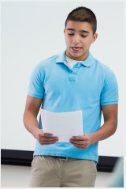
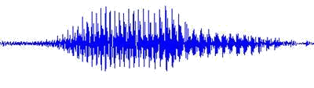
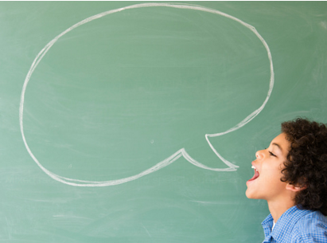
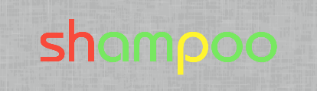
Goal: System that provides pronunciation feedback
Notes:
הנושא הראשון- הפרדיגמה הסטנדרטית לניקוד הגייה. הולכת ככה:
מקבלים דיבור מהתלמיד, משווים אותו להגייה של דובר שפת אם, וחוזים את הציון שמומחה אנושים היה נותן.

Slide 4
Overview

Slide 5
phoneme alignment (“forced alignment") algorithms
Given a speech with its phonetic content, finds the start time of each phoneme.
Also outputs a confidence for each of the phonemes and a global confidence.
Current pronunciation feedback systems use phoneme alignment algorithms which are mostly based on HMM.
Notes:
Phoneme alignment (“forced alignment") algorithms. Given a speech utterance along with its phonetic content, phoneme alignment algorithms outputs alignment of the speech into the given known phonemes of the spoken word, giving each phoneme a start time, thus dividing the speech into time blocks of frames for each phoneme.
The phoneme aligner also outputs a confidence for each of the phonemes and a global confidence in its prediction.
Current pronunciation feedback systems use such algorithms which are based on HMM – Hidden Markov Model.

Slide 6
The algorithm proposed in
A Large Margin Algorithm for Speech-to-Phoneme and Music-to-Score Alignment By Joseph Keshet, Shai Shalev-Shwartz, Yoram Singer and Dan Chazan
Describes a new non HMM-base phoneme alignment algorithm.
In out project we explored this algorithm in order to maximize the measure of performance used to evaluate alignments. We changed it to output reliable scores for each spoken phoneme.
Notes:
In out project we explored this algorithm in order to maximize the measure of performance used to evaluate alignments, rather than to just maximize
probabilities, as traditionally done in HMM-based algorithms, and change it to output scores for each spoken phoneme.

Slide 7
The System’s Flow

Slide 8
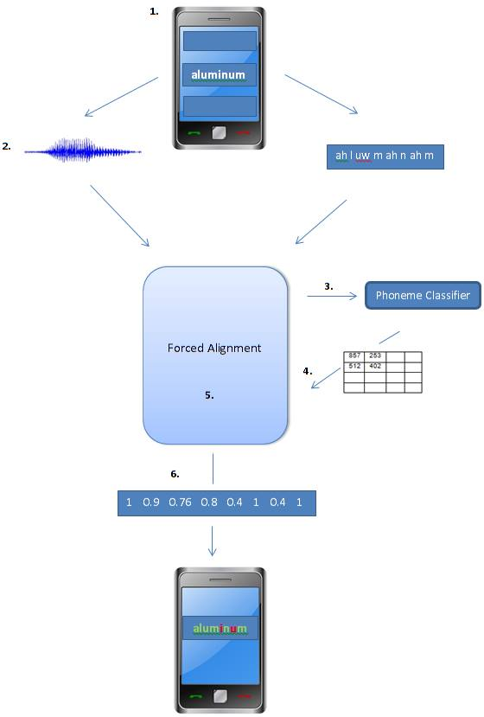

Slide 9
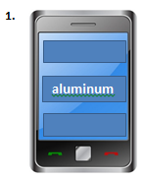
1. In the application we built, a word or a phrase to be pronounced is chosen by the user from a readymade list, where the canonical phonetic content of this word or phrase is known.

Slide 10
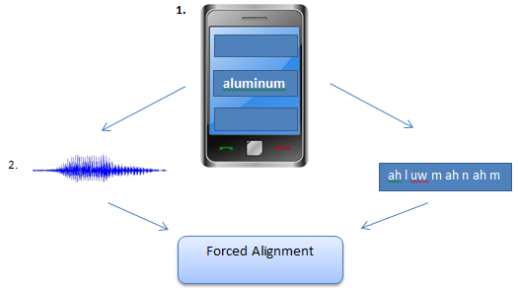
2. The user's voice is recorded and along with its canonical phonetic content it is served as an input to a phoneme alignment algorithm on the server side.

Slide 11
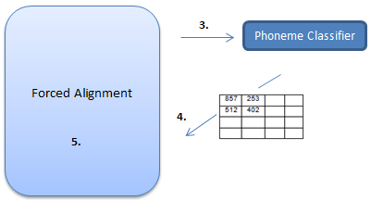
3. The algorithm uses a phoneme classier module to provide scores for each phoneme at each time frame of 10 milliseconds.

Slide 12
4. It finds the most probable start time (frame) of each phoneme by calculating the “path", the partition of the speech into blocks of frames, which maximizes the total sum of scores.

Slide 13
5. For each frame the algorithm compares between the score given to the desired phoneme, which was given as input, and the maximum score given among all the phonemes, which represents the phoneme the user most likely said. The final scores for each phoneme is the ratio between these two scores. It ranges from 0 to 1 and defines the distance between the user's and the desired pronunciation.

Slide 14
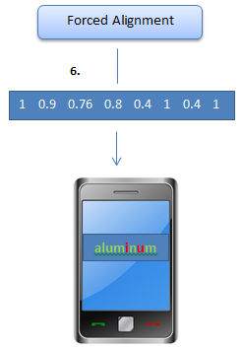
6. The server then sends these final scores to the client application, and it presents the mispronounced phonemes (those with lower scores) visually.

Slide 15
The Project’s Process

Slide 16
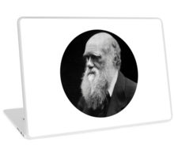

1.Technical Setup
Moving the original code and modules from the current Mac Darwin operating system into our Linux Ubuntu operating system, where we would carry out the research and code changes.

Slide 17


Handling technical problems, which required inquiry about the differences between the operating systems, appropriate recompilation of the modules and binaries, and OS-depended changes in the code.

Slide 18

2. Background Learning of the Algorithm
Learning the paper: A Large Margin Algorithm for Speech-to-Phoneme and Music-to-Score Alignment By Joseph Keshet, Shai Shalev-Shwartz, Yoram Singer and Dan Chazan
Notes:
As mentioned, as a side effect, the algorithm uses scores for each time block which represent the quality of the desired phoneme recognition and directly implies the quality of the user’s pronunciation of this phoneme.

Slide 19
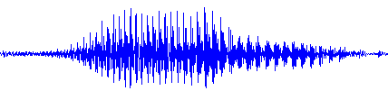




As mentioned, when computing the start time of each phoneme, the algorithm uses scores for each time block which represent the quality of the desired phoneme recognition.
0.8
0.6
0.7
0.9

Slide 20
The problem: the nature of the scores mentioned above was not very clear:
Were distributed in non restricted range.
Didn’t behave uniformly for different kinds of speeches (sentence vs. word, different speaker’s native language…)
Were not reliable enough to use them as is to make the desired final prediction of the user’s pronunciation quality.
175
430
356
100
Notes:
The problem was that the nature of the scores mentioned above was not very clear. They were distributed in non restricted range, they didn’t behave uniformly for different kinds of speeches (such as whole sentences VS single words, American English native speakers VS Hebrew native speakers, etc.), and were not reliable enough to use them as is to make the desired final prediction of the user’s pronunciation quality.

Slide 21
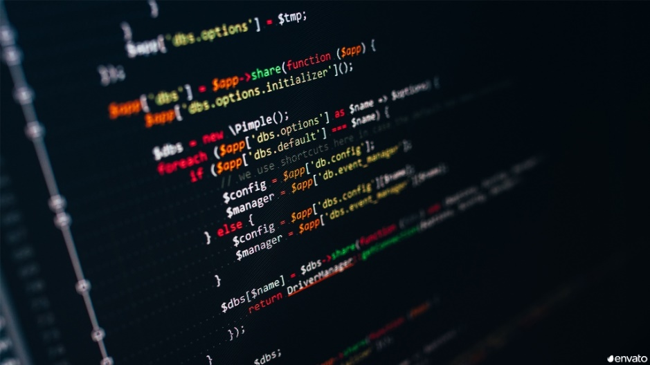
3. Adapting the Code to Our Needs
We changed the current code so we could get the scores for every possible phoneme.
Doing this allowed us to examine the quality of the scores, and their behavior according to different inputs.
Notes:
Changing the current code implementing the algorithm, so we could get the scores for every possible phoneme, and not only for the word's phonemes received in the input. Doing this allowed us to examine
the quality of the scores, and their behavior according to different inputs.

Slide 22
4.Creating Data for Experiments
Given TIMIT dataset of speech utterances and their phonetic content, we performed various manipulations on it, such as:
Switching between syllables/phonemes in the same sentence.
Michel colored the bedroom wall with crayons
Michel coloreb the dedroom wall with crayons
Michel colored the bedroom wall yith crawons
Notes:
Given data containing many speech utterances and their phonetic content, we performed various
manipulations such as switching between syllables/phonemes in the same sentence, or or cutting out
single words with their corresponding phonemes, in order to achieve utterances in various pronunciation
levels.

Slide 23
Cutting out single words with their corresponding phonemes.
Michel colored the bedroom wall with crayons
wall
Michel
bedroom
crayons

Slide 24
Removing / adding silent frames in the beginning/ending of an utterance.
All of it, in order to achieve utterances in various pronunciation levels to perform effective experiments.

Slide 25
Experiments

Slide 26
Forced Alignment Algorithm
0.8
0.6
0.7
0.9

Slide 27
1. Understanding the algorithm behavior
With this data we tried to figure out the behavior of the algorithm scores.
Results
The scores were not always uniform, and an objective look on a standalone score can't determine whether it's good or bad.
70
65
30
89
450
300
512
486
Notes:
With the data we created we carried out experiments to figure out the behavior of the algorithm scores.
We mainly examined whether it indeed gives good scores for correctly pronounced words\sentences, and bad scores for those which were badly pronounced.
Results
The results informed us with two issues:
The scores were not always uniform, and an objective look on a standalone score can't determine whether it's good or bad.
Sometimes a higher score is given to a different phoneme, say `a', other than to the one which was supposed to be said, say `b', although the user's speech does sound good and similar to `b', and seemingly has no reason to be interpreted as `a'.

Slide 28
Sometimes a higher score was given to a different phoneme, than to the correct one, seemingly without any reason.
bedroom
The correct phpnems and therir scores
The phpnems with tha maximum scores
b eh sil d r uh m
f eh sil l r uh m
300 415 512 600 315 400 360
400 415 512 800 315 400 360

Slide 29

Conclusions and Hypotheses
These issues raised questions on whether the algorithm is influenced by other speech features such as:
Duration of the utterance.
A whole sentence V.S. a single word.
Michel colored the bedroom wall with crayons
V.S.
Michel
bedroom
crayons
Notes:
Conclusions and Hypotheses
These issues raised questions on whether the algorithm is influenced by other speech features such as:
Duration of the utterance.
A whole sentence or a single word.
Silent frames at the beginning/ending of an utterance { do they increase or decrease the quality of the phoneme recognition and hence the final scores, and do cutting them out improves the algorithm performance.

Slide 30
Silent frames at the beginning/ending of an utterance - do they increase or decrease the quality of the phoneme recognition, and do cutting them out improves the algorithm performance.
SIL
SIL

Slide 31
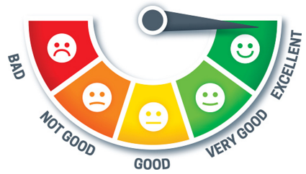
2. Normalization Approach
We have researched for different ways to normalize the the scores, in order to:
Make them more robust to the speech differences mentioned above.
Transfer them into a restricted scale which we could use to determine a threshold for classifying the pronunciation quality.
Notes:
We have researched for different ways to normalize the the scores, in order to make them more robust to the speech differences mentioned above, and mainly to transfer them into a restricted scale which we could use to determine a threshold for classifying the pronunciation quality. E.g. For a scale between
1 - 5 the score is higher as the quality gets better.
We have learned the following paper:
- Automatic scoring of pronunciation quality { By Leonardo Neumeyer, Horacio Franco, Vas-silios Digalakis and Mitchel Weintraub
which suggests different methods to normalize the score of an utterance into a scale of 0-1.

Slide 32

We have learned the following paper:
Automatic scoring of pronunciation quality By Leonardo Neumeyer, Horacio Franco, Vassilios Digalakis and Mitchel Weintraub
which suggests different methods to normalize the score of an utterance into a scale of 0-1.
0
0.2
0.4
0.6
0.8
1

Slide 33
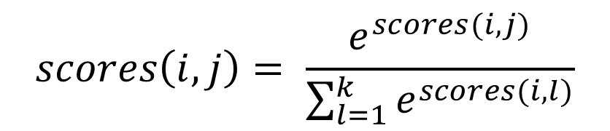
After consultations about the normalization methods suggested, we applied the following:
For each time block i representing a spoken phoneme:
For each possible phoneme j:
$$scores\left(i,j\right)= \frac{e^{scores(i,j)}}{\sum_{l=1}^{k}{e^{scores(i,l)}}}$$

Slide 34
Results and Conclusions
Normalization does not significantly improve the scores quality.
Reduction to a smaller scale makes it more difficult to realize a proper threshold between “bad" and “good" scores, as the scale shrinks.

Slide 35


3. Types of Speech Input
We tried to measure the score of a word when it's part of the sentence VS when it stands by itself. Results and Conclusions
We discovered that when the utterance is only a single word the algorithm does not influenced by the word's context inside the sentence, and does perform more accurately.
Michel colored the bedroom wall with crayons
V.S.
bedroom

Slide 36
We tried to measure the score of a speech utterance:
With silent frames at its beginning/ending and respectively add the ‘sil’ signals to its phonetic content.
When cutting the silent frames out.
SIL
SIL

Slide 37

Results and Conclusions
We found that the algorithm perform slightly better when cutting off the silent frames, but not by much.

Slide 38
4. Types of Final Scores Output
We examined various approaches for determining the most accurate final scores the algorithm should output for the user's phonemes pronunciation:

Slide 39
Give the original score calculated by the phoneme classier module, which regards to the right phonemes for the word, as given in the input. Conclusions: Not so good, as we mentioned above. Non uniform scores, that do not match to a restricted scale which allow clear classifying of ‘good’ and ‘bad’ pronunciation quality.

Slide 40
Give the phoneme having the maximal score given by the phoneme classier, for each block of frames in the utterance, and present it as the output to the user - as to tell him he sounded more like this phoneme than the desired correct one. Conclusions: Non measurable output, which does not exactly meets the original goal of pointing the user towards how far he is from correct pronunciation.
You should have said:
But you sounded more like:
b eh sil d r uh m
f eh sil l r uh m

Slide 41
Present the difference between the two scores mentioned above: The maximal score - the score of the correct phoneme. Conclusions: Better, since addresses the previous approaches’ problems. But- still not good enough, because it ignores the scores' original scale (since it only gives their difference), thus not always representing the severity of the difference. In addition, does not solve the scaling problem - do not give a clear range and threshold for the pronunciation quality.

Slide 42
Present the ratio between the two scores mentioned. Conclusions: So far the best and most accurate solution, which addresses all the problems we ran into.

Slide 43
Main Struggles
Once we could use the application to record data of our own, we discovered the algorithm behaves differently applied on this records than on the TIMIT data we used for development.

Slide 44
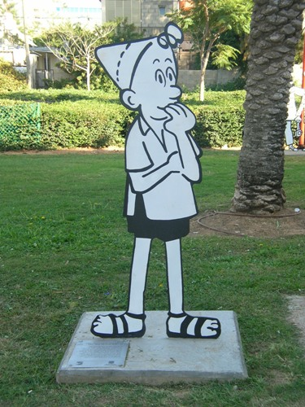
We raised a hypothesis that the reason is that the current phoneme classier was trained only on English native speakers data, and could have interpreted wrongly the slight differences in the Israeli accent.

Slide 45
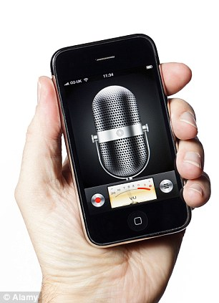
As we tried to confirm this hypothesis we:
Created corpus of data from our own records to represent Hebrew native speakers' pronunciation.

Slide 46
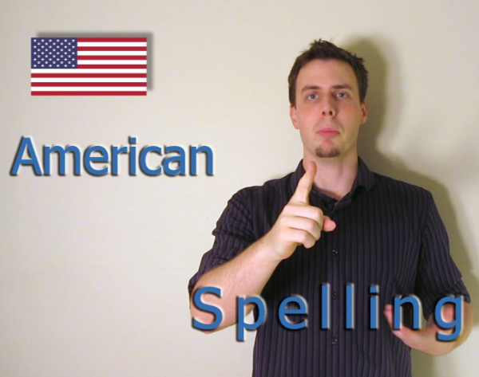
Extracted new data of English native speakers' pronunciation from YouTube for example.
Compare the algorithm performance upon them.

Slide 47
At first it seemed that our hypothesis is correct, since the scores did behave differently for both kinds of data.
But a deeper examination of the scores, along with Dr. Keshet estimations brought us to a new conclusion that what is needed is re-calibration of the thresholds we used for classifying ‘good’ and ‘bad’ pronunciation.
We also figured out it's best if we add another ‘medium’ level to the thresholds, for scores that are not strictly fall into neither of the definitions of completely `good' or `bad'.

Slide 48
Our android application is based on communication with a server running the forced alignment algorithm.
During the development we used a local server running on our Linux VM, but for the final project delivery we obviously needed a proper server with a static IP address which will be running continuously.

Slide 49
With the help of Dr. Keshet we received a server to work on from the university.
But we ran into several technical problems with it, which mostly resulted from the fact it was running a windows, and the use of Cygwin, which couldn't run our modules and binaries properly.
Another issue was that we had problems with accessing it from outside of the university network.

Slide 50

While trying to handle these issues, we tried various alternatives.
We decided the best way for now is to use Google Cloud Platform services to host a virtual machine running Ubuntu, where we copied and installed all that is needed to run our server.

Slide 51
Future Thoughts
For future progressions in general; If one wants to apply the algorithm on a more specific types of speakers, he can always train the classier on a this specific type of speech data in order to achieve better and more accurate results.

Slide 52
With the purpose of applying the application for Hebrew native speakers learning English, one can use a better phoneme classier module, which is more robust to Israeli speech, thus can output more accurate scores and enhance the total algorithm performance.

Slide 53
In addition, the application, and also the algorithm generally, can be adapted for the use of teaching deaf to speak appropriate English, with correct pronunciation.

Slide 54

Thank you

